Slide 1
Vertical Markets Agricultural Operations
Baldwin Filters Value Proposition
Notes:
Internal definition only - not to be presented

Slide 2
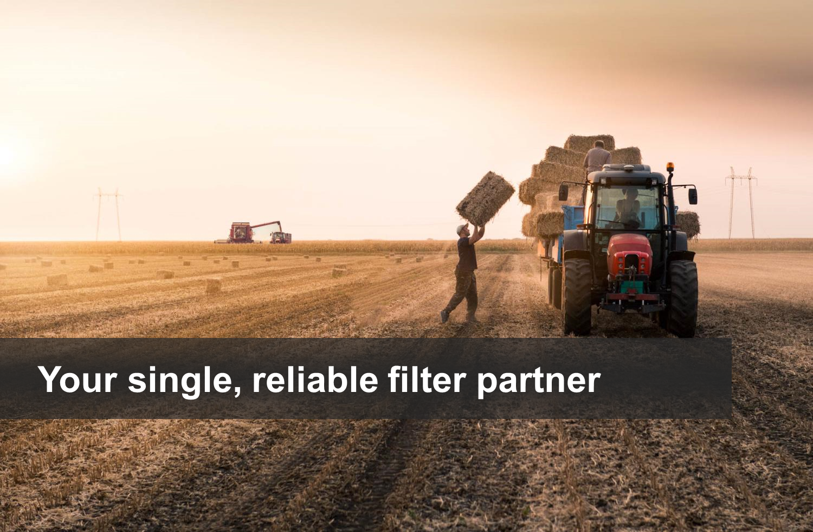

Slide 3
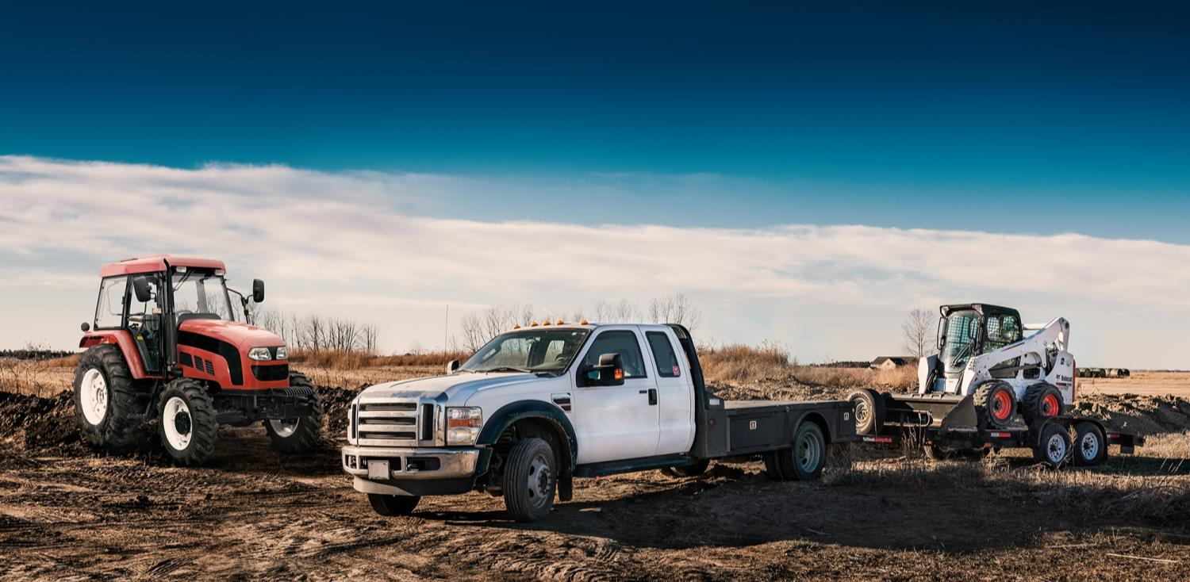
Daily Challenges
Productivity
Breakdowns & Delays
Parts Availability
Weather
Maintenance Costs
Conflicting Priorities
Cash Flow
Time

Slide 4
Equipment Issues
Parts on Hand
Too much is expensive
Too little causes downtime waiting or running
Lost Productivity from unscheduled downtime
Short or unmet service intervals
Premature parts failure
Quality and Reliability
Damage from misapplication
Long term issues and reduced engine life

Slide 5
Baldwin Filters Can Help
Your single, reliable filter partner
Heavy Duty market leader with reputation for quality and service
OE level protection or better
Over 7000 filters for complete coverage
Broad distribution for prompt local service
Technical support second to none

Slide 6
Heavy Duty Market Leader
500,000+ filters/parts made per day
6 Sigma Quality
Sophisticated in-house test labs
Scientists and engineers constantly developing patented new technologies
Notes:
This is Aftermarket
UCI

Slide 7
Reputation For Quality & Service
Baldwin advantages over the competition
Experience. People. Integrity. Work ethic.
1st choice for a high quality, well constructed filter.
Baldwin stands behind their product and their reps are always eager to help in any way possible.
Top quality at an affordable price.
Industry leading quality, broad range of available filters, fast shipping.
Baldwin makes model specific filters, not “Will Fit” like other competitors.
Very knowledgeable and their employees are personable and pleasant to deal with.
Very reliable filters, great customer service.
Helpful and accessible, great coverage, always releasing new products.
Great customer service team… they can answer/fix any question I have.
The wonderful Nebraska people!
Quotes taken from a 2017 customer survey

Slide 8
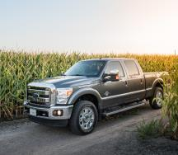
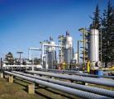
Now Even Stronger With Parker
Parker can be found on and around everything that moves
We manufacture highly engineered components and systems that facilitate motion and the controlled flow of liquids and gasses for a wide variety of global markets to increase our customers’ productivity and profitability.
Aerospace
Climate Control
Electromechanical
Filtration
Fluid & Gas Handling
Hydraulics
Pneumatics
Process Control
Sealing & Shielding
Notes:
Dialog - access to advanced technologies and the synergies thereof, will enable Baldwin to offer even more and better products to benefit you, our customers

Slide 9
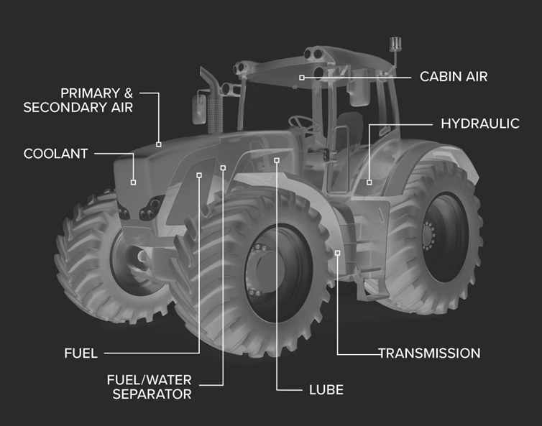
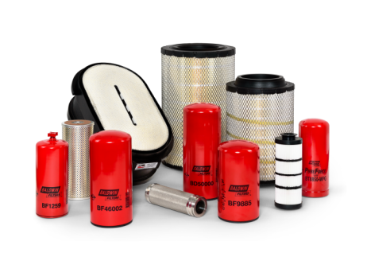
Complete Filter Coverage
Every type of filter you need
Air
Fuel
Lube
Hydraulics
Coolant
Transmission

Slide 10
Broad Application Coverage
Filters for all major makes and models
Equipment & Vehicles
Engines

Slide 11
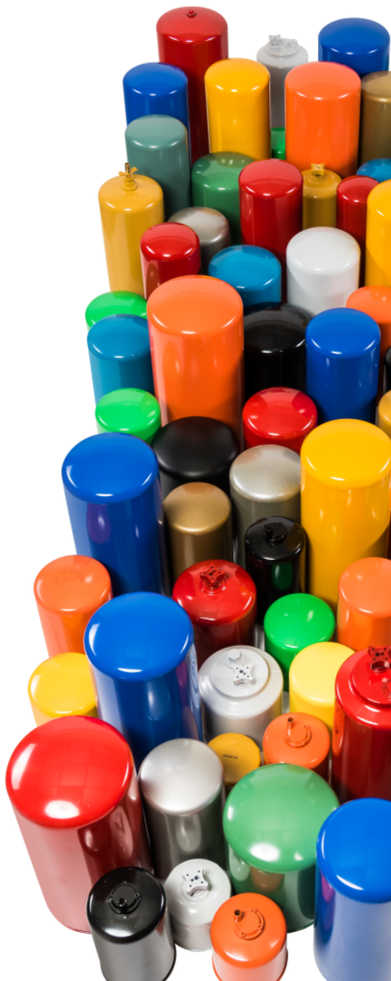
OE Filter Supplier
Manufacture 150+ brands
First Fit and OES preferred supplier
Engine manufacturers
Off-road equipment
On-road vehicles
ISO 9001 / TS 16949
Certified OE Manufacturer

Slide 12
Innovative Technologies
Application based design
Hundreds of available media grades to meet application specific requirements
Fibers, seals and compounds all tested for chemical compatibility and strength
Advanced processes: co-pleating, laminating, deep pleating, precision robotics, microscopic quality assurance
Proprietary Protura® nanofiber media produced in-house
Highly engineered multi-layered HELM™ liquid media
Fluted Channel Flow™ air filter media
Notes:
We have hundreds of media grades available to us as part of Parker/legacy CEMG. At the moment, EMAM actively uses 66 different grades.
The ProTura nanofiber used in the XP line of air filters is higher efficiency compared to the competitive nanofiber because the size of our fibers are smaller than the competitive product. It is far more efficient capturing sub-micron sized contaminants (0.3 to 1.0 microns). When used in HVAC applications, these medias far exceed all recommendations for indoor air quality - capturing virtually all bacteria sized particles. Your engine will be “breathing” cleaner air than you do!
HELM™ Highly Efficient Multilayered Media is tailored to the requirements of each application. Every layer serves a specific purpose; particle removal, capacity, water removal, strength, etc. Fiber and Media selection + layering + configuration + reinforcing techniques + pleating etc. = highly engineered
Parker has invested in the latest media development, manufacturing, converting, and testing capabilities. The Parker Filtration Innovation Center (PFIC) in Columbia, TN coupled with the Parker’s Corporate Technology Ventures in Macedonia, OH position Parker to be a leader in filtration innovation well into the future.
Innovative technology means more up-time and lower overall cost of ownership.
Examples of “nonstandard” tests we perform that ensure each filter meets the requirements of a specific application:
A test performed to measure the bursting strength of paper or paperboard. In a Mullen test (also called a pop test), the paper sample is placed between two ring-like clamps in a device called a Mullen tester, and hydraulic pressure is used to inflate a rubber diaphragm, which expands against the sample stretching it. The measure of the total hydraulic pressure expanding the diaphram at the time the sample ruptures (usually expressed in either pounds per square inch or kilopascals) is its bursting strength
Vibration
High/low temperature
Chemical soaking

Slide 13
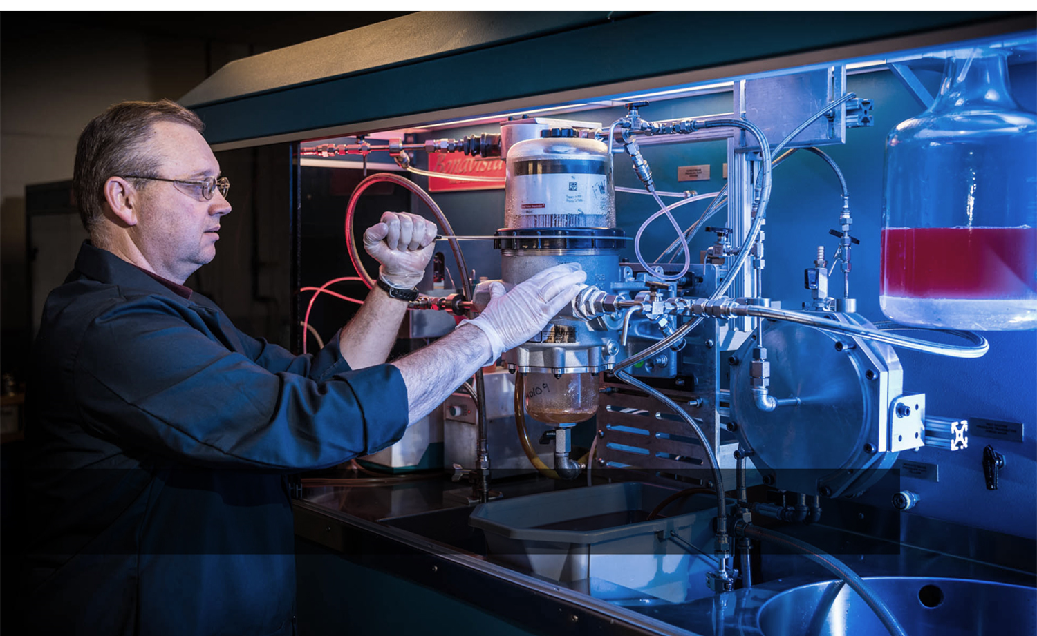
Verified performance
Notes:
Chemical compatibility of materials
Media sheet strength
Media flat sheet efficiency
Multi-pass efficiency and capacity
Fuel/water separation performance
Initial restriction
Cold flow restriction
Burst and collapse ratings of cans & center tubes
High temperature tests of media & seal integrity
Vibration tests simulate life-time efficiency and structural stability
Strict quality control for 6 sigma level results

Slide 14
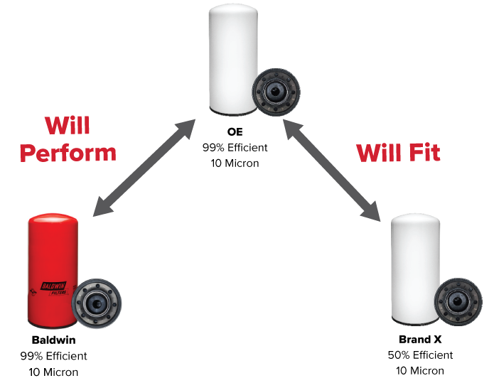
Baldwin Protects Like the OE
Will Fit vs.
Will Perform
NO Cross!
Baldwin can not control how competitors claim to “cross” their products
Notes:
39
40
37
In order to protect like the OE intended, a filter must do more than have the right dimensions and thread. It must meet efficiency requirements at target micron sizes (not all 10 micron filters are alike – does it catch 50% or 99% of all contaminants 10 microns and larger?), capacity, chemical compatibility and durability of media/gaskets/seals/potting compounds, initial and final pressure drop/flow restriction, high temperature and vibration tolerance etc. all over the full life of the filter. Baldwin carefully studies the requirements of every application to ensure that our filters will protect your equipment over the full service interval, just as well or even better than the OE. (sometimes we can solve/improve some unforeseen shortcomings of the original design)

Slide 15
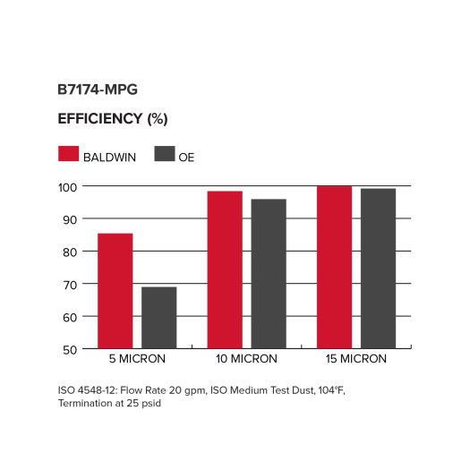
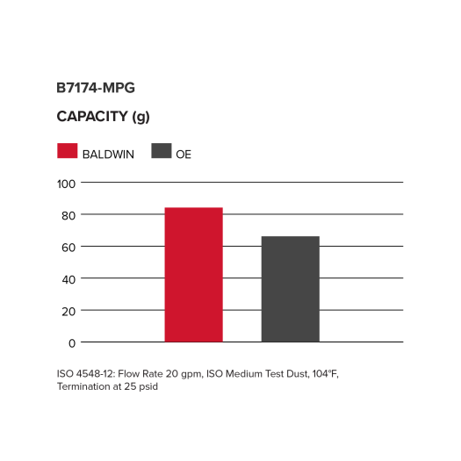
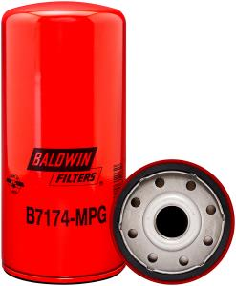
High Performance Lube Filters
Maximum Performance Glass
B7174-MPG Provides unsurpassed protection for Case-IH, Iveco and New Holland equipment
Replaces Iveco 99445200
Notes:
With the widespread use of synthetic oils, longer service intervals are becoming more and more common. In order for an oil filter to be suitable for extended use, it must be efficient at the target particle size (high efficiency under 10 microns may strip valuable additive molecules, reducing your oil’s lubricating properties), have adequate capacity, AND be durable enough to withstand extreme conditions over a long period of time. A filter that falls apart may “last”, but it will not be providing protection to your engine. Media, potting compounds, seals/gaskets and overall design must all be reliable for the entire filter life. Baldwin engineers and tests for all these variables and more.

Slide 16
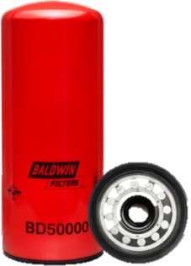
Lube Filters with HELM™ Media
High capacity and durability for long life
NEW Highly Engineered Layered Media simultaneously improves both efficiency and capacity, perfect for new oils
Replaces Fleetguard LF14000NN
BD 50000 Dual-Flow Lube Spin-on fits tractors, loaders, combines, excavators, trucks and other HD equipment with Cummins QSM, QSK, QST30, ISM, ISX15, X15 engines
Notes:
With the widespread use of synthetic oils, longer service intervals are becoming more and more common. In order for an oil filter to be suitable for extended use, it must be efficient at the target particle size (high efficiency under 10 microns may strip valuable additive molecules, reducing your oil’s lubricating properties), have adequate capacity, AND be durable enough to withstand extreme conditions over a long period of time. A filter that falls apart may “last”, but it will not be providing protection to your engine. Media, potting compounds, seals/gaskets and overall design must all be reliable for the entire filter life. Baldwin engineers and tests for all these variables and more.
High Efficiency Dual-Flow Lube Spin-on fits Tractors, loaders, combines, excavators, trucks and other HD Equipment with Cummins QSM, QSK, QST30, ISM, ISX15, X15 Engines

Slide 17
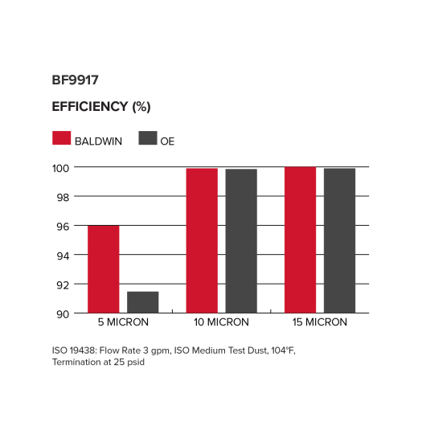
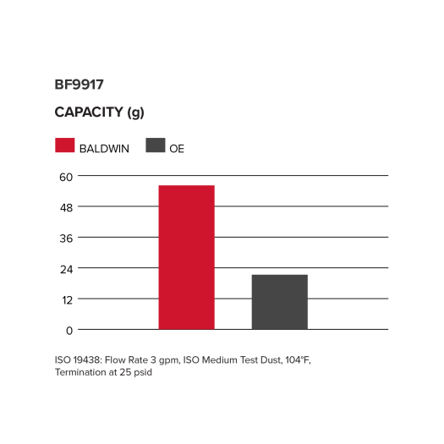
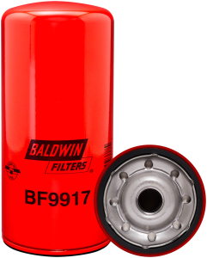
High Performance Fuel Filters
Capture and hold the smallest particles
BF9917 Provides unsurpassed protection for John Deere tractors, dozers, harvesters and excavators
Replaces Deere RE533910
Notes:
Replaces Deere RE533910
The smallest contaminants, under 5 microns, can cause the worst damage to today’s high pressure fuel systems. With internal pressures beyond 30,000 psi and clearances down to 1-2 microns, the smallest particles can act like a sand-blaster on your high pressure pump and injectors. For comparison, a pressure washer capable of stripping paint or cleaning grease from concrete is generally in the 1000 -3000 psi area.

Slide 18
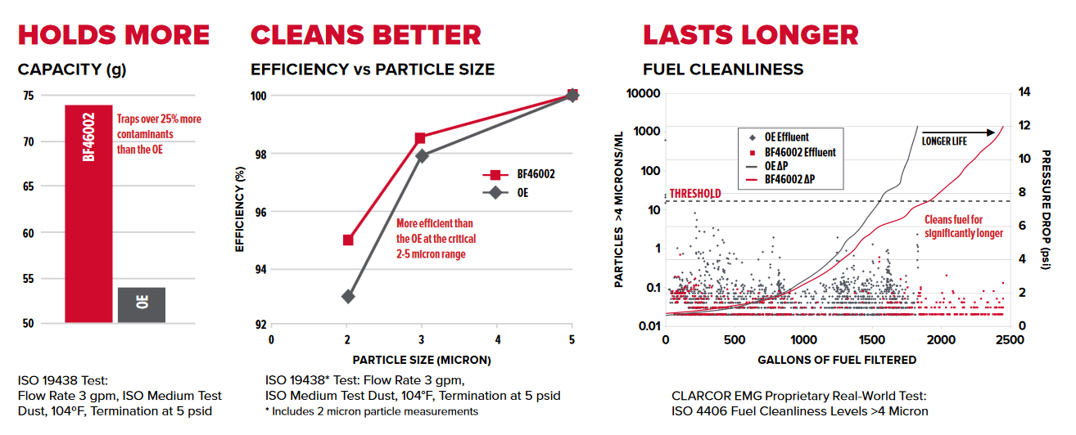
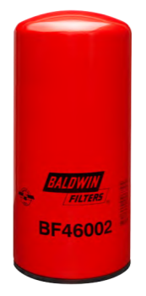
Fuel Filter with HELM™media
Dual-stage design for extra protection
BF46002 with highly engineered layered media protects HD equipment with Cummins QSK engines better than OE
Replaces Cummins 2881458
Notes:
Hitachi, John Deere, Kawasaki, Komatsu, Terex, Euclid, Heavy-Duty Off-Road Equipment all with Cummins QSK MCRS Engines (19L, 38L, 50L, 6L) and KTA - plus Cummins QSK Marine engines
The smallest contaminants, under 5 microns, can cause the worst damage to today’s high pressure fuel systems. With internal pressures beyond 30,000 psi and clearances down to 1-2 microns, the smallest particles can act like a sand-blaster on your high pressure pump and injectors. For comparison, a pressure washer capable of stripping paint or cleaning grease from concrete is generally in the 1000 -3000 psi area.

Slide 19
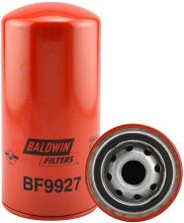
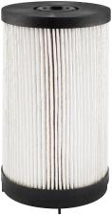
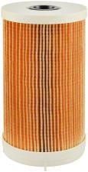
High Performance Fuel Filters
Capture and hold the smallest particles
BF9927, PF9928 & PF9929 NEW fuel filters for heavy duty Kenworth & Peterbilt trucks with Paccar MX and Cummins ISX engines
Replaces
Paccar 1655115
Replaces Paccar K371004 , K371009
Notes:
The smallest contaminants, under 5 microns, can cause the worst damage to today’s high pressure fuel systems. With internal pressures beyond 30,000 psi and clearances down to 1-2 microns, the smallest particles can act like a sand-blaster on your high pressure pump and injectors. For comparison, a pressure washer capable of stripping paint or cleaning grease from concrete is generally in the 1000 -3000 psi area.

Slide 20
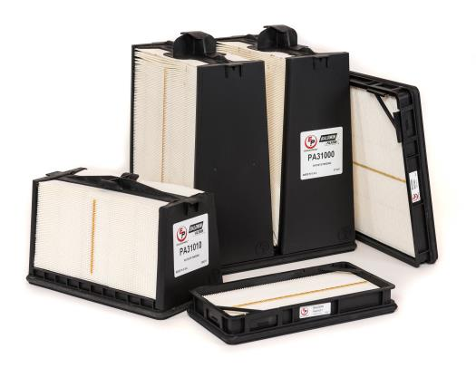
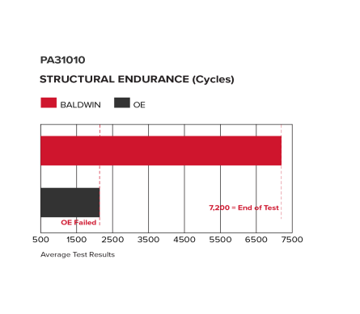
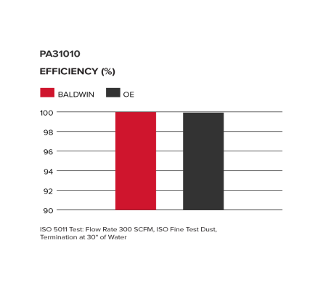
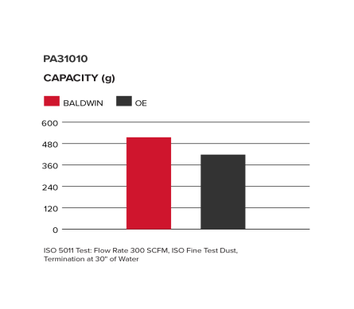
NEW EnduraPanel™ Air Filters
Superior protection for off-road equipment
NEW EnduraPanel™ technology combines high efficiency and capacity in an extremely rugged, compact design that outperforms the OE
NEW PA31010 EnduraPanel™ Air Filter fits Bobcat loaders, use with PA31011 safety filter. More EnduraPanel filters coming soon.
Notes:
New technology to replace and outperform FleetGuard Direct Flow air filters
Not only must an air filter be highly efficient at capturing contamination, it must also hold onto them for the full life of the filter. This makes structural stability and media strength critically important. Contaminant by-pass (going around, not through the media), failed seals or adhesives, and microscopic holes in the media itself will render a filter practically useless. Baldwin builds strength into every filter component and has developed proprietary test methodologies to ensure our air filters protect your vehicle just as well on the last day, as they did on the first day. We test for the most extreme conditions and for much longer than typical service intervals.

Slide 21
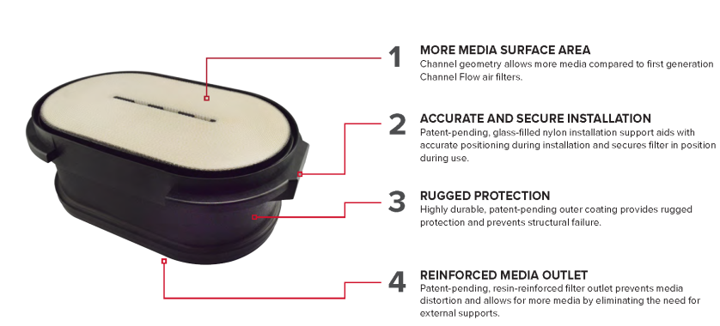
Channel Flow EXO™ Air Filters
Highest efficiency over the full filter life
Channel Flow EXO are built extra tough to maintain structural integrity under the harshest conditions and outperform the competition
CA30102 replaces Paccar P611698 on heavy duty Kenworth trucks
Notes:
New technology to replace and outperform Donaldson PowerCore™ filters
CA30102 fits Kenworth T440, T470, T660, T800
Not only must an air filter be highly efficient at capturing contamination, it must also hold onto them for the full life of the filter. This makes structural stability and media strength critically important. Contaminant by-pass (going around, not through the media), failed seals or adhesives, and microscopic holes in the media itself will render a filter practically useless. Baldwin builds strength into every filter component and has developed proprietary test methodologies to ensure our air filters protect your vehicle just as well on the last day, as they did on the first day. We test for the most extreme conditions and for much longer than typical service intervals.

Slide 22
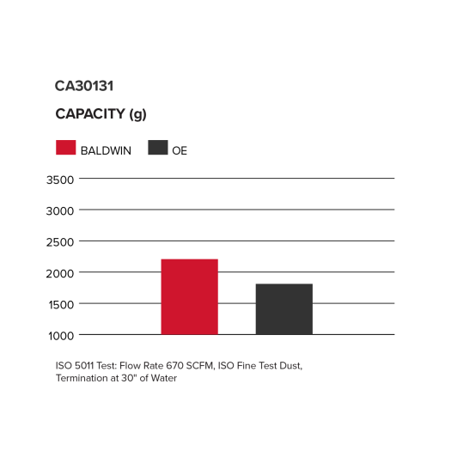
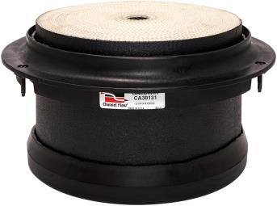
NEW Channel Flow EXO™ Round
Tough protection for hard working dump trucks, snow plows, cement mixers…
CA30131 Fits Freightliner 108SD w/Cummins ISL (8.9L), ISB (6.7L) Engines
CA30132 Fits Freightliner 114SD w/Cummins ISC, ISL and ISL-G engines; Western Star 4700 w/Cummins ISL, ISC and DD13 engines
CA30131 Replaces P621097
CA30132 Replaces P619498
Notes:
New technology to replace and outperform Donaldson PowerCore™ filters
Fits work trucks like dump trucks, snow plows, concrete mixers etc.
Not only must an air filter be highly efficient at capturing contamination, it must also hold onto them for the full life of the filter. This makes structural stability and media strength critically important. Contaminant by-pass (going around, not through the media), failed seals or adhesives, and microscopic holes in the media itself will render a filter practically useless. Baldwin builds strength into every filter component and has developed proprietary test methodologies to ensure our air filters protect your vehicle just as well on the last day, as they did on the first day. We test for the most extreme conditions and for much longer than typical service intervals.

Slide 23
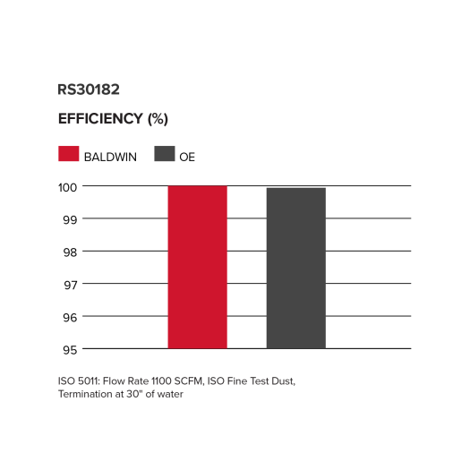
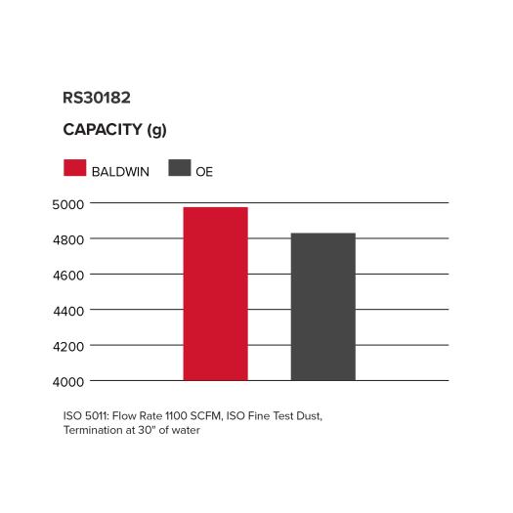
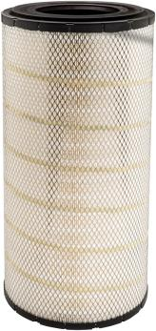
Premium Radial Seal Filters
Perform in the toughest, dirtiest conditions
RS30182 provides OE level protection to Fendt combines, Massey Ferguson and New Holland harvesters
Replaces
New Holland 84072431 Donaldson P789638 Fleetguard AF26214
Notes:
New technology to replace and outperform FleetGuard Direct Flow air filters
Not only must an air filter be highly efficient at capturing contamination, it must also hold onto them for the full life of the filter. This makes structural stability and media strength critically important. Contaminant by-pass (going around, not through the media), failed seals or adhesives, and microscopic holes in the media itself will render a filter practically useless. Baldwin builds strength into every filter component and has developed proprietary test methodologies to ensure our air filters protect your vehicle just as well on the last day, as they did on the first day. We test for the most extreme conditions and for much longer than typical service intervals.

Slide 24
Broad Distribution Network
Your choice of distribution partner
Prompt local service and delivery
Customized cross-reference and application guides
Guarantees local inventory
Notes:
Use this slide when distributor unknown and not involved in the conversation - otherwise use the next slide instead

Slide 25
Dependable Local Service
Local inventory
Prompt delivery
Responsive service
Filter surveys
Recommended stock levels and orders
12 month price guarantee
Use this slide instead of the previous one when distributor is already known:
Insert distributor logo here and customize bullet points – make accurate for the circumstance!
Notes:
Customize to actual situation

Slide 26
Strong Manufacturer Support
98% 24 hour DC fill rate
Virtual 100% order accuracy
Stable, competitive pricing
Product sourcing to ensure one stop shop
Technical training at the plant or in the field

Slide 27
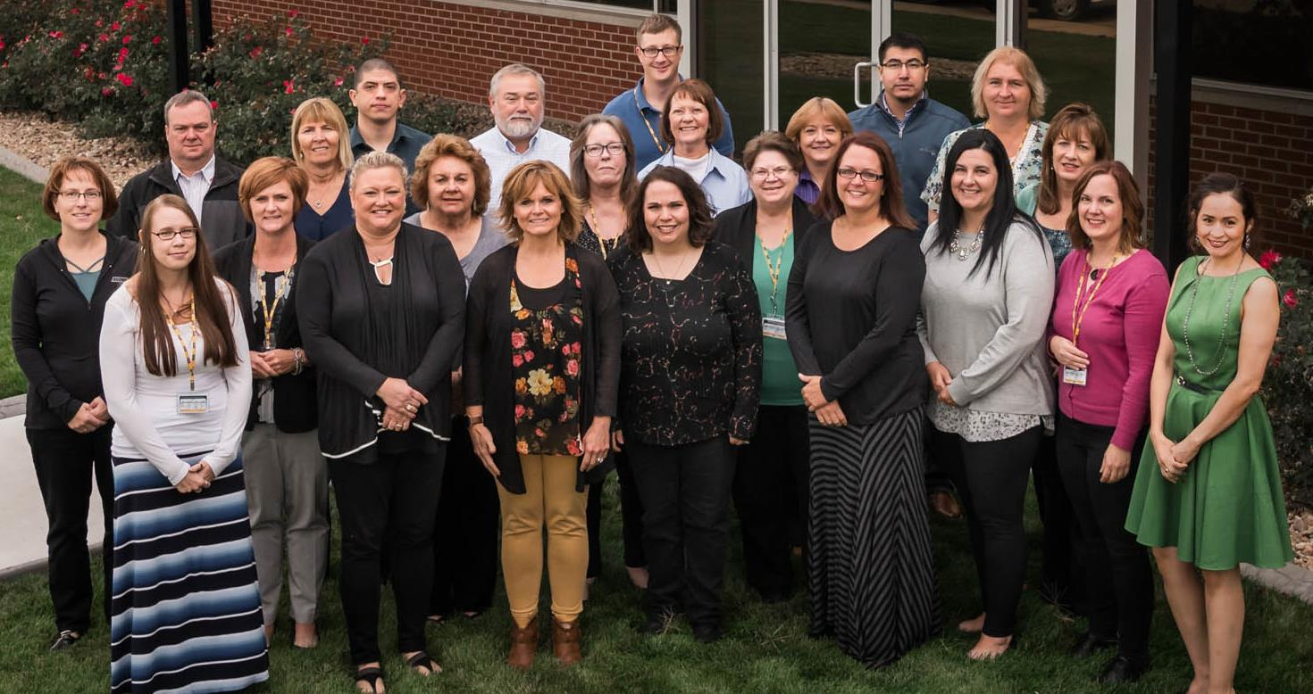
Expert Inside Support Team

Slide 28
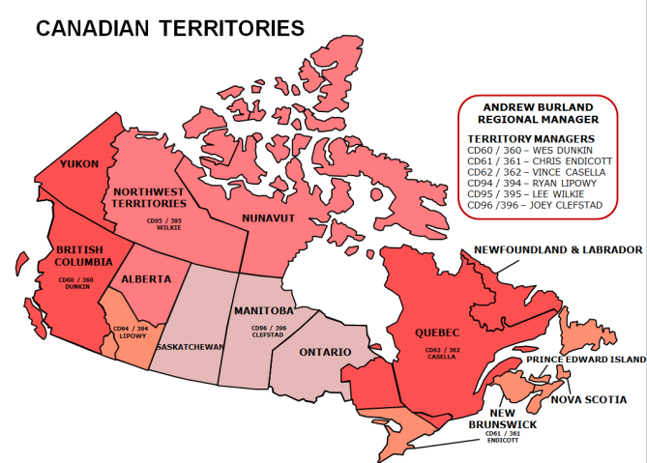
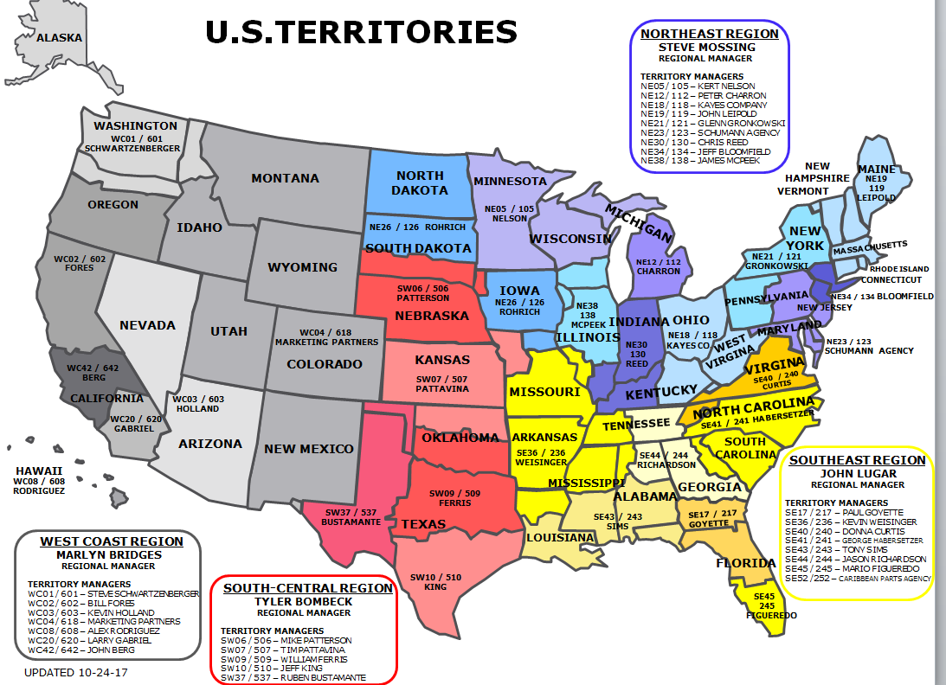
40+ Field Sales Staff
National Account Team
Andy Sisler
Brad Harmeyer
Heather Swanson
Jack Deasy
Kent McGinnis
Ron Norman
Shannon Sullivan

Slide 29
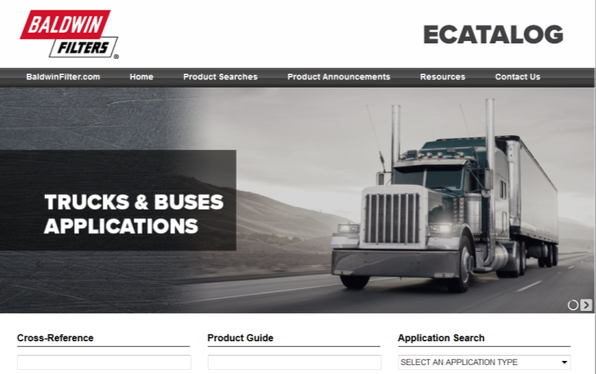
The Right Filter Every Time

Slide 30
Contacts
Baldwin is here to support you
Territory Manager
Customer Service | order.desk@clarcor.com | (308) 237-9700
Technical Hotline | hotline@baldwinfilter.com | (308) 237-9706
Service Engineering | serviceengineering@baldwinfilter.com | (308) 237-9729
Or call toll free: (800) 822-5394 At Baldwin you will always speak with a real person, not a machine!

Slide 31
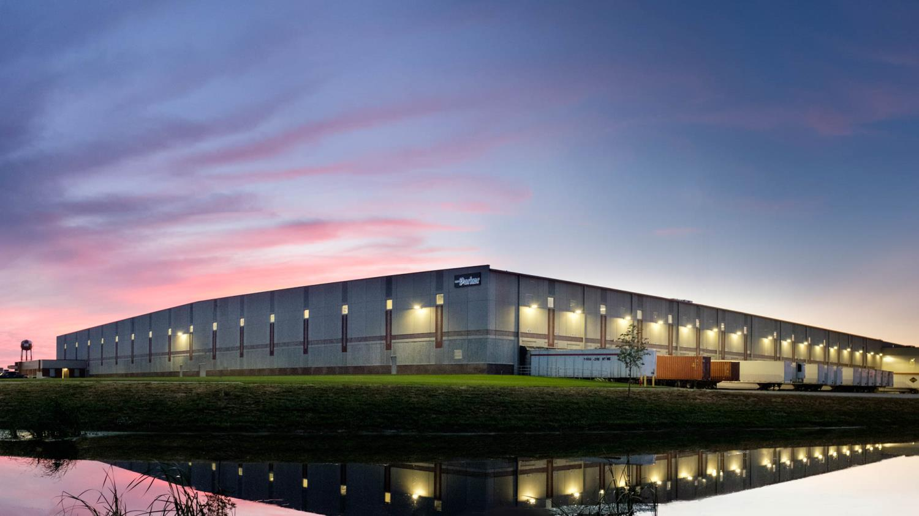
Next Steps

